Slide 1








VORTEXA
3.0
12 HRS HACKATHON
POWERED BY A.I.R.S
DOMAIN & NO : GoVTech (7), G-01
PROBLEM STATEMENT TITLE : RozgarLink: Skills-to-Opportunity Matching Engine
TEAM NAME : NPM INSTALL AURA
TEAM ID : VTX26-43648

Slide 2


PROBLEM STATEMENT
G-01: match skills to opportunities, without ever letting an AI score decide who is eligible.
THE PROBLEM
WHAT BREAKS, AND OUR RESPONSE
The G-01 problem
Listings describe the same skill in different words, so keyword search hides roles from qualified candidates. Worse, eligibility conditions (a candidate must meet them) get mixed with preferences (they only affect ranking).
Problem | Practical consequence | RozgarLink response
Keyword dependence | Equivalent skills in different wording are missed | Alias normalisation + semantic similarity
Eligibility mixed with preference | High skill match wrongly implies the candidate qualifies | Deterministic mandatory-criteria check before any ranking
Opaque recommendations | Candidates cannot see why a role appears or which condition failed | Criterion-level eligibility and score breakdowns
Skill gaps without action | Missing skills shown with no next step | Gaps mapped to the team’s learning catalogue
Stale results | Profile changes leave rankings outdated | Automatic, visible recalculation after edits
Unverified information | A qualification or skill is wrongly assumed present | Unknown, unverified and demonstrated states kept separate
Requirement treated as preference
Recommends jobs a candidate cannot formally take.
Preference treated as requirement
Hides options the candidate could still pursue.
Core rule: eligibility is not an AI score
Needs 2 years of experience, candidate has 6 months: not eligible, however high the semantic skill similarity.
Missing evidence returns “needs more information”, never a pass. AI may interpret skills and rank eligible roles; it must never override a failed condition.
Goal: which roles a candidate can legitimately pursue.
Scope and limits
  Opportunities are manually entered or seeded (no live scraping)
  Course catalogue is team-supplied (no live course APIs)
  Scores signal relevance, not eligibility or hiring odds
  Matching must stay understandable, consistent and responsive when candidate details change
Notes:
G-01 asks for a matching system that separates mandatory eligibility from preference-based ranking, recognises skills described in different words, explains every result, recommends learning from a team-supplied catalogue, and recalculates when candidate data changes. The core rule: eligibility is decided by explicit criteria, never by an AI score.
TALK TRACK: Left = what the problem is and the one rule we never break. Right = each failure of today's systems and our fix, row by row. Close on scope so nobody over-reads our claims.

Slide 3
IDEA TITLE / PROPOSED SOLUTION
Validate → Match → Explain → Guide. Rules decide who qualifies; AI ranks, explains and teaches.
HOW IT WORKS: 5-STEP PIPELINE
WORKED EXAMPLE: JUNIOR DATA ANALYST
Candidate profile
skills, qualifications, location, preferences
Opportunity record
explicit mandatory + preferred criteria
Mandatory: any degree, 1+ year experience, SQL
Preferred: remote, Power BI (ranking only)
1 Deterministic eligibility engine
checks mandatory criteria only; no AI score involved
 | Profile facts | Outcome and explanation shown
A | B.Sc., 18 months, SQL, lists “BI dashboards” | Eligible, ranked. “BI dashboards” matched to Power BI (self-reported, semantic)
B | B.E., 6 months, SQL, very high skill similarity | Not eligible. Fails “at least 1 year experience”; reason displayed
C | Degree not stated in profile | Needs more information. Qualification missing, so not assumed to pass
Not eligible
Exact failed condition shown; excluded from ranking.
Needs more info
Missing fact is named; never assumed to pass.
Eligible
All mandatory criteria met; continues to ranking.
2 Semantic skill matching
aliases + embedding similarity
3 Preference-aware ranking
eligible only, versioned weights
4 Explanation + skill gaps
criterion-level reasons, gap analysis
5 Catalogue learning path
or “no resource available”
Three guarantees
  No false matches: a failed mandatory condition is never shown as eligible
  No black boxes: every result carries a plain-language reason
  No stale results: edits recalculate visibly
Any profile edit or new evidence triggers visible recalculation of steps 1 to 5.
Notes:
The pipeline has one hard boundary: step 1 is deterministic. Only results that pass step 1 reach semantic matching and ranking. The worked example shows the same job producing three different outcomes for three candidates.
TALK TRACK: Walk the left pipeline top to bottom (rules first, AI after). Then use the right-hand example: same job, three candidates, three different outcomes. End on the three guarantees.

Slide 4
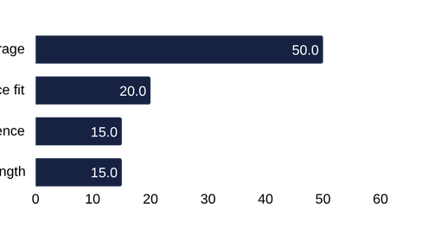
TECHNICAL APPROACH
Portals call a Node/Express API; the API calls a deterministic core and AI adapters. AI has no path into eligibility.
ARCHITECTURE: TOP TO BOTTOM
MATCHING CORE, AI AND STACK
Candidate / job seeker
Recruiter / employer
Training provider
Admin (restricted)
DETERMINISTIC MATCHING CORE (rule-based)
Stage 1 Eligibility engine: Eligible, Ineligible or Needs more information, with a reason per criterion
Stage 2 Ranking: eligible only
Also: explanation builder, skill-gap engine, learning-path mapper
HTTPS + JWT session
CLIENT
Next.js + React + TypeScript + Tailwind + shadcn/ui
  Candidate, Recruiter and Provider portals
  Landing + auth, language selector (English + 22)
  Mic/camera capture, demo-mode labels
  Dashboard, opportunity entry, profile editing, match explanations
AI + LANGUAGE (advisory)
Gemini: Career Assistant, skill extraction + similarity
Groq: AI Tutor lessons in English, Hindi, Marathi
Browser speech: tutor voice via speechSynthesis, no extra key
Ranking weights (eligible only)
starting values, tuned on labelled fixtures
BACKEND API: Node.js + Express
secrets and AI calls stay server-side
Security: JWT auth + roles, validation, rate limiting
Safety: upload checks, audit logging, rate-limited AI endpoints
Ranking: eligible candidates only
Orchestration: matching runs again whenever profile data changes
GUARDRAIL AI may interpret skills, rank eligible results and explain them. It can never decide or override eligibility.
DATA: MongoDB + controlled file storage
users, candidates, opportunities + versioned criteria, skills + aliases, applications, resources, match results, resume versions, interview sessions, audit log
  Criteria are versioned; each result ties to the criteria used
  Timeouts, cache and labelled demo mode if a service is down
Notes:
Read the diagram top to bottom: portals call a Node/Express API; the API calls the deterministic matching core and the AI adapters. AI output only feeds ranking and explanations; it has no path into the eligibility engine. Weights shown are an initial proposal, not validated values.
TALK TRACK: Left = layers (users, client, API, data). Right = the brain: rule-based core in navy, advisory AI in amber, weights chart, and the red guardrail that AI can never override eligibility.

Slide 5
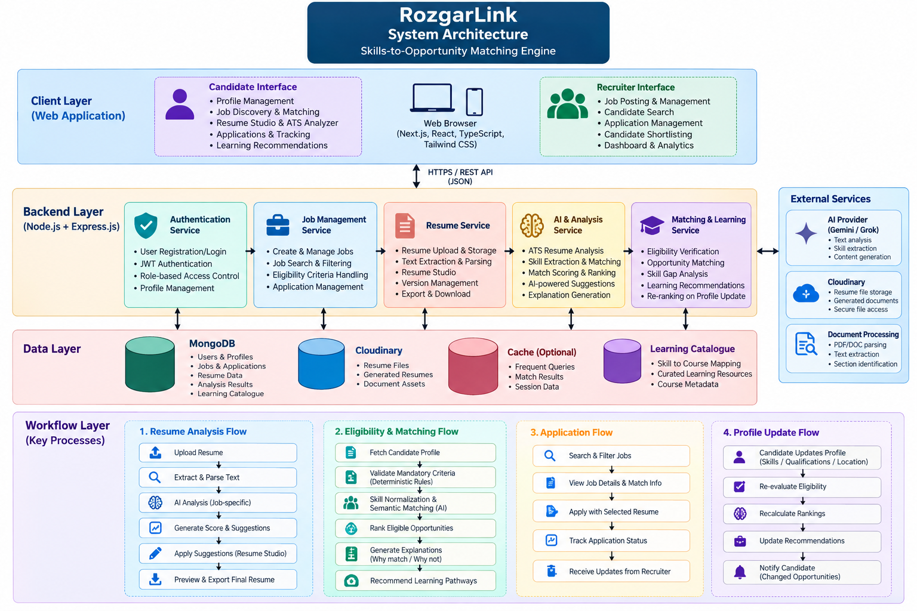
SYSTEM ARCHITECTURE
Four layers, four workflows; rule-based eligibility stays apart from AI.
HOW IT FLOWS
Eligibility + matching
  Mandatory criteria checked first
  Eligible roles ranked, then explained
  Gaps mapped to catalogue resources
Profile update
  Candidate edits skills or location
  Eligibility and rankings recalculate
  Candidate notified of changed roles
Rules first, AI second
  Eligibility engine is deterministic
  AI adds ranking signals only
  Profile → eligibility → skills to build
Notes:
Read the diagram top to bottom: client layer (candidate and recruiter interfaces), backend services (auth, jobs, resume, AI and analysis, matching and learning), data layer (MongoDB, file storage, optional cache, learning catalogue) and the four workflows. TALK TRACK: Left = the full architecture. Right = the flows that matter most: eligibility and matching, profile updates, and rules first / AI second.

Slide 6
FEASIBILITY AND VIABILITY
Most modules are already built; remaining effort is verification, polish and reporting measured test results.
WHY IT IS FEASIBLE AND VIABLE
BUILD ORDER AND KEY RISKS
Most
modules already built in the working prototype
8
eligibility test scenarios incl. boundary + missing-data cases
0
eligibility violations targeted on the test suite
100%
of displayed results targeted to carry a grounded explanation
Priority sequence, not clock time
Core foundation
MVP core
G-01 core engine
MVP core
Learning pathway
MVP core
Applications + employer workflow
MVP core
Why it is feasible
  Mainstream stack: Next.js, Node + Express, MongoDB
  Eligibility core is plain, testable rules; no model training
  AI sits behind server-side adapters with timeouts, caching and labelled demo modes
  Fits a 12-hour build: seeded opportunities, team catalogue, no scraping or live course APIs
  MVP scope: manual opportunities, curated catalogue
Career-support modules
Stretch
Career Assistant + AI Tutor (EN/HI/MR)
Stretch
Verification + polish
Verification
Key risk | Mitigation
Ambiguous employer criteria | Explicit criterion types; unclear criteria flagged at creation
AI hallucination | Grounded in supplied data; candidate approves edits; no invented credentials
API outages or quotas | Adapters, timeouts, cache, labelled demo modes
Limited catalogue coverage | “No resource available” shown; providers expand it
Why it is viable
  Versioned criteria keep every result auditable
  Role catalogue and languages extend without frontend rewrites
  Providers grow the catalogue; weights stay tunable
  Focused, testable workflow first; expand later
Notes:
Status: most modules are already built. Remaining effort is verification, polish and reporting measured test results. Targets on this slide are evaluation criteria, not measured outcomes; real numbers will be reported after testing.
TALK TRACK: Left = proof it can be done (stats are targets, not measured results) and why it lasts. Right = the order we build in and the four risks with mitigations.

Slide 7
IMPACT AND BENEFITS
Everyone in the pipeline gets transparency: what matched, why, and what to do next.
WHO BENEFITS
TODAY VS WITH ROZGARLINK
Candidates
  See why a role appears and which condition failed
  Equivalent skills recognised even when worded differently
  Skill gaps lead to catalogue resources or an AI Tutor session (EN/HI/MR) with PDF notes
Today | With RozgarLink
Keyword search misses equivalent skills | Alias and semantic matching with evidence
Eligibility mixed with preference | Deterministic eligibility first, then ranking
Opaque recommendations | Criterion-level reasons and score breakdowns
Skill gaps with no next step | Catalogue-based learning path, or an honest “none available”
Stale results after profile edits | Visible recalculation after every change
Employers
  Define mandatory and preferred criteria once, clearly
  Top 5 / 10 / 20 ranking of eligible applicants, with explanations
  Ineligible applicants stay viewable with the failed condition; shortlisting is a human action
Measured at prototype stage
  Eligibility correctness on written test cases
  Matching quality vs a keyword-only baseline
  Explanation coverage and update latency
An honest limit
A hackathon prototype shows correctness and usability. Employment or placement gains need deployment, usage data and participant consent.
Benefits are validated with test cases and user feedback.
Training providers
  Resources tagged to canonical skills surface at the moment of need
  Level, duration and prerequisites drive sequencing
  Review workflow: only approved resources reach the Learning Hub
Notes:
Benefits are intended outcomes. At the prototype stage we measure system correctness and usability; we do not claim employment or placement improvements.
TALK TRACK: Left = three audiences and what each gets. Right = before/after table, then what we actually measure and the honest limit (we do not claim placement gains).

Slide 8
DIFFERENTIATOR
Existing tools are strong at reach and volume; RozgarLink adds rules-first eligibility that quotes the stated condition.
EXISTING APPROACHES VS G-01
WHAT MAKES ROZGARLINK DIFFERENT
Existing approach | What it does well | Typical gap vs G-01
National Career Service portal | National reach: job matching, counselling, skill info, Bhashini; recent public descriptions list AI matching and skill-gap analysis | Public descriptions do not show per-criterion pass/fail quoting each stated condition
Commercial job portals (Naukri, LinkedIn, Indeed) | Large listing volume, filters, recommendations | Requirements mostly free text; no formal pass/fail before ranking
Learning platforms (SWAYAM/NPTEL, Coursera) | Broad course content and certificates | Courses not derived from the gap of a specific opportunity
Resume / ATS checkers | Quick keyword and format feedback | Opaque scores; can reward keyword stuffing; not tied to eligibility
General AI chatbots | Flexible conversational advice | Not grounded in structured criteria; hard to audit
Eligibility firewall
AI similarity can never decide or override eligibility
1
Reasons that quote the rule
Explanations use the opportunity’s own condition
Three honest states
Eligible, not eligible, or needs more information
Aliases, not look-alikes
Equivalent skills matched; merely related ones kept separate
Gaps tied to learning
Catalogue resources, or an AI Tutor session; “none available” if neither
Versioned and live
Criteria versioned; results recalculate visibly
6
Truthful AI tools
Resume and interview AI never fabricate; candidate approves changes
Positioning
A transparent, auditable eligibility-first matching layer. It complements national platforms such as NCS rather than replacing them; the same rules-first approach could sit in front of any opportunity source.
Comparison reflects public descriptions of these services and is not an audit of their internal logic.
Notes:
Existing services are strong at reach and volume. Our difference is narrow and deliberate: rules-first eligibility with explanations that quote the stated condition, and AI that is advisory only. Verify the NCS row against ncs.gov.in before presenting.
TALK TRACK: Left = what others do well and where they fall short of G-01. Right = our seven differences, then positioning as a complement to NCS.

Slide 9










THANK YOU!
Game’s
Still On
VORTEXA 3.0
AIRS

